Slide 1

President’s FY 2025 Budget Increases Education Funding, But Total Remains Below the 2011 Inflation-Adjusted Level (Department of Education Discretionary Funding in Billions of Dollars)
2017, 2019, 2020, 2021, 2022 & 2023 totals reflect rescissions of Pell Grant funds
Notes:
Update for 2024 and 2025, and footnote

Slide 2
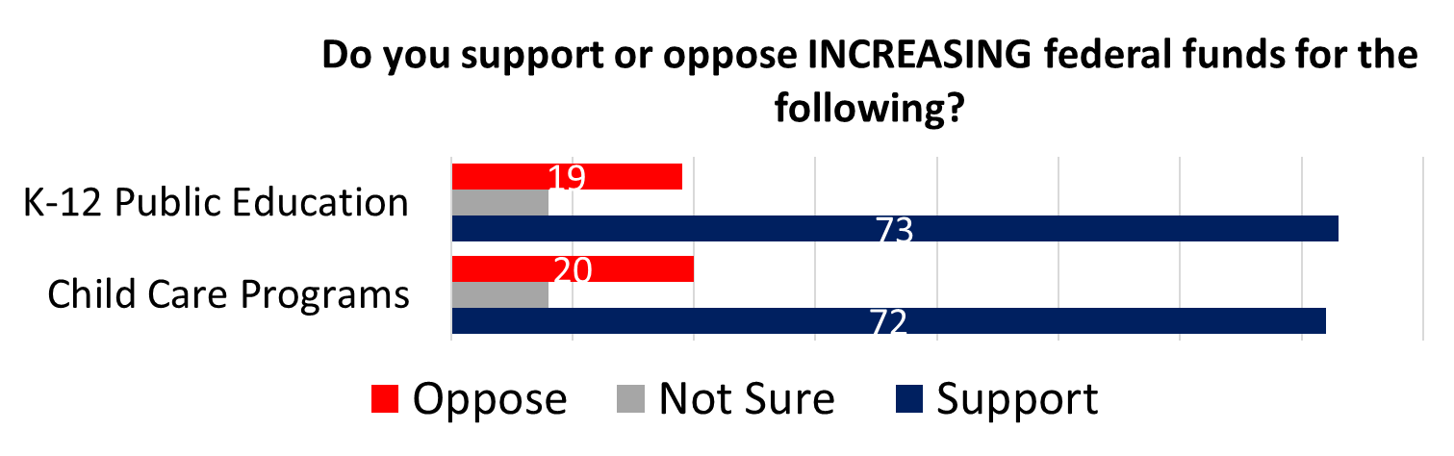
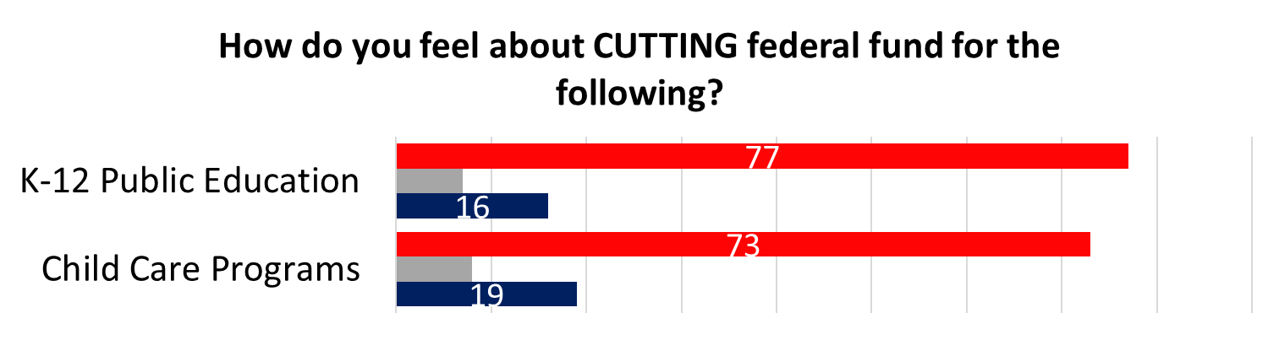
Big Majorities Oppose Cuts to Education and Child Care Funding,
and Support More Funding
Source: Navigator Research poll, 11/30/23

Slide 3
Education Accounts for 2.3% of President’s 2025 Budget
SOURCE: CEF based on FY2025 OMB Budget

Slide 4
Apart from Emergency Relief, Education Funding Held Mostly Flat under Spending Caps in Effect from 2013-2021 and 2024-2025 (Department of Education Discretionary Funding in Billions of Dollars)
Years with caps on discretionary spending
2017, 2019, 2020, 2021, 2022 & 2023 regular totals reflect rescissions of Pell Grant funds

Slide 5
Department of Education Funding: President’s Requested Change and Enacted Change
Obama
Trump
Biden
Source: Department of Education FY 2025 request and budget history tables

Slide 6
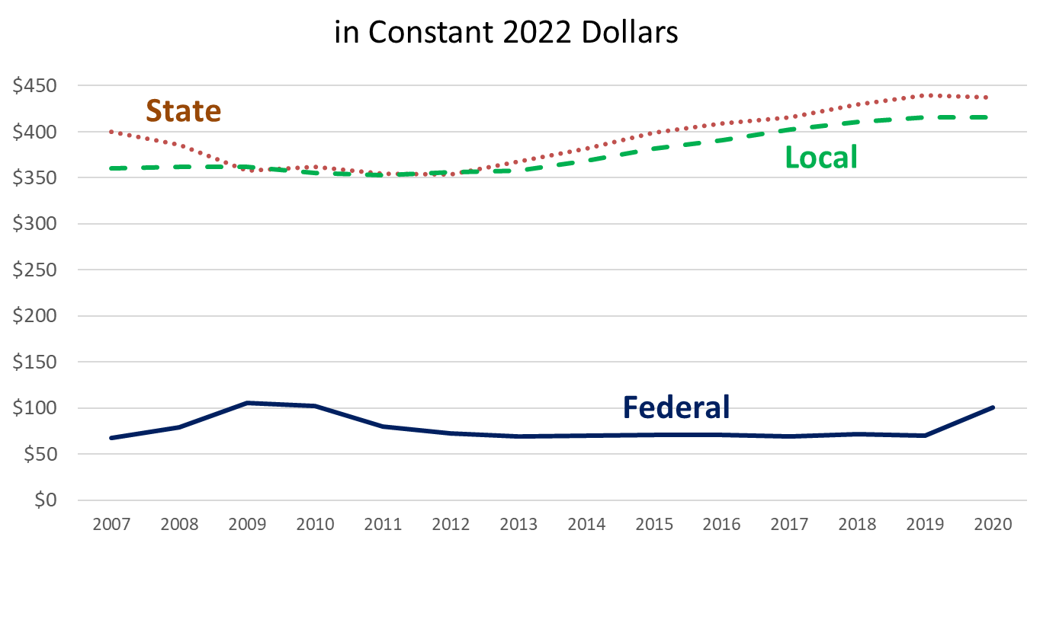
Federal Support for Education Increased Only Briefly Due to Temporary Emergency Funding
Revenue in billions
SOURCE: National Center for Education Statistics, Digest of Education Statistics 2023,
Table 235.10.

Slide 7
President’s FY 2025 Education Department Discretionary Funding
Additional mandatory funding requested for K-12 academic grants, reducing costs of college fund, and free community college
Source: CEF based on Education Department budget request

Slide 8
Federal Funding Has Barely Increased Over the Last Decade Except for K-12 Education (Discretionary nominal dollars, in billions)

Slide 9
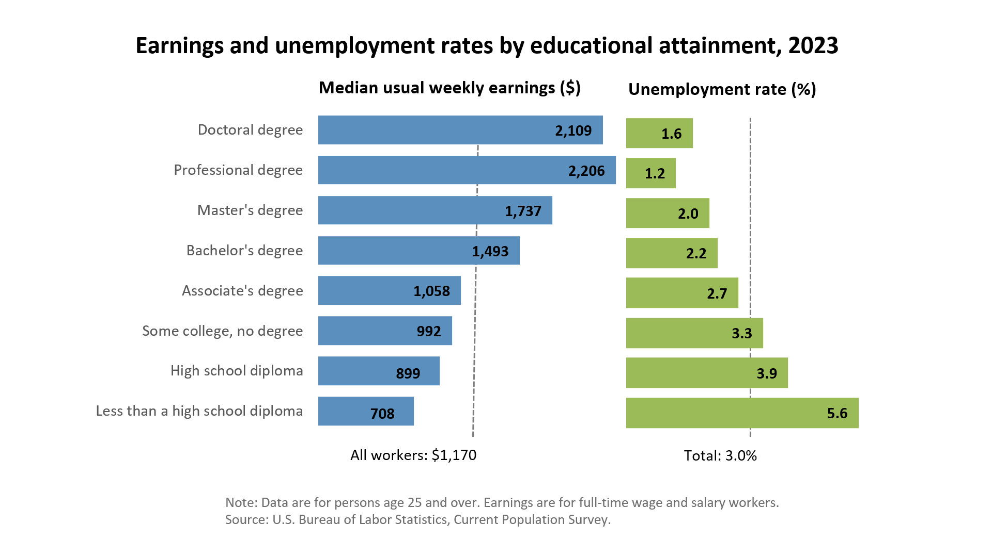

Education Pays: More Education Leads to Higher Wages and Employment

Slide 10
Special Education: Federal Share Just 1/4 of “Full Funding” Despite President’s 2025 Funding Increase, Leaving Cost Burden to State and Local Budgets
Source: CRS and ED funding history
Notes:
NEED TO ADD 2024 LEVEL STILL
% of full funding, 1988-2017 from https://ncd.gov/sites/default/files/NCD_BrokenPromises_508.pdf
% covered for 2023=2025 Pres in FY 25 CJ, table on page 25

Slide 11
Despite Requested Increase, Maximum Pell Grant No Longer Covers Much of Average Cost of College
$24,030
Source: College Board “Trends in College Pricing 2023” and ED

Slide 12
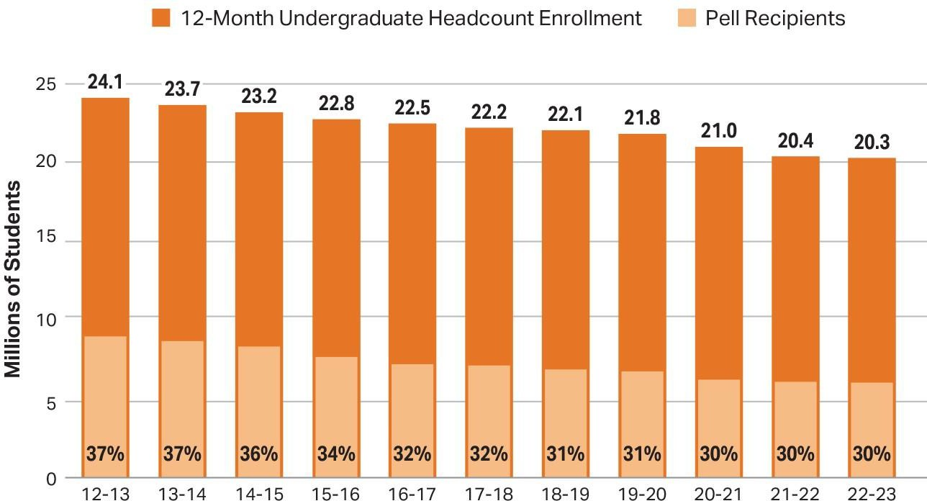
Almost One-Third of Undergraduates Receive
Pell Grants
Source: The College Board, Trends in College Pricing and Student Aid 2023, Figure SA- 17A.

Slide 13
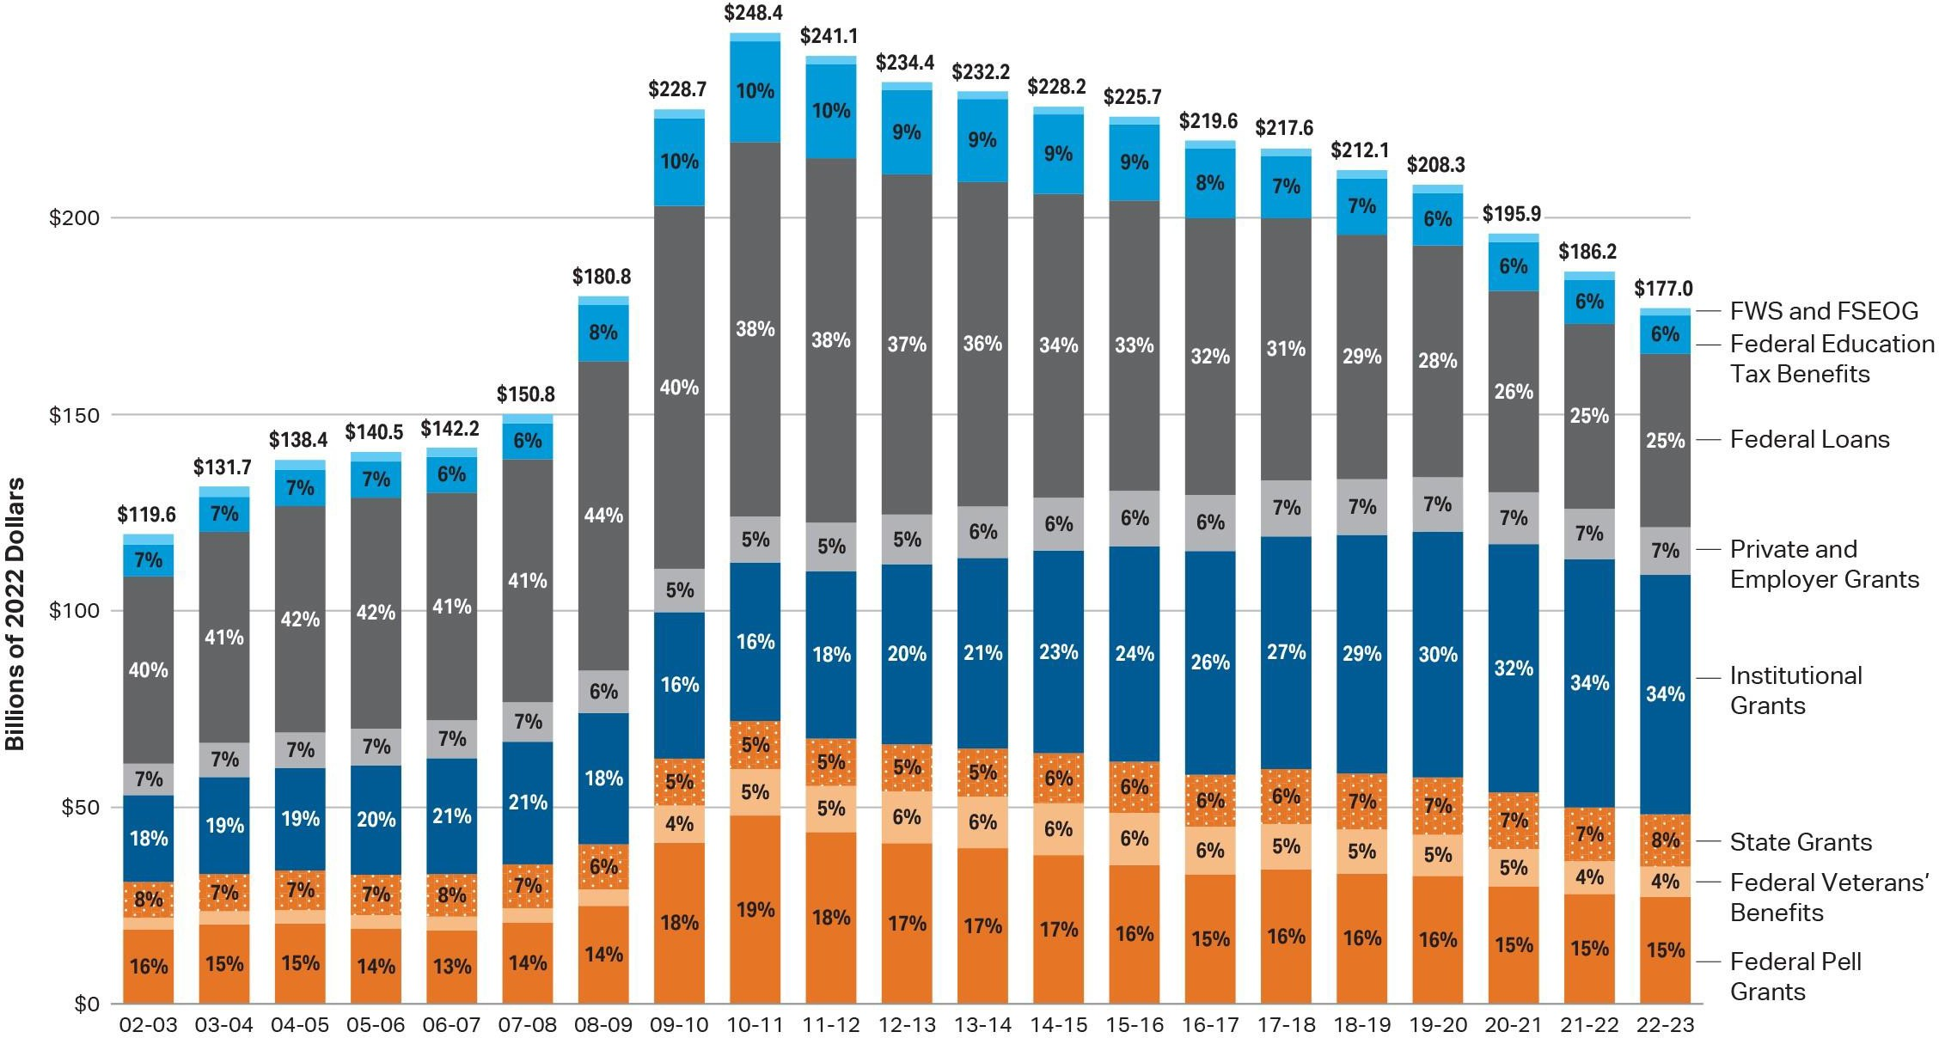
Federal Support Falls to 51% of
Smaller Total of Undergraduate Student Aid
Source: College Board, Trends in College Pricing and Student Aid 2023, Figure SA-3

Slide 14
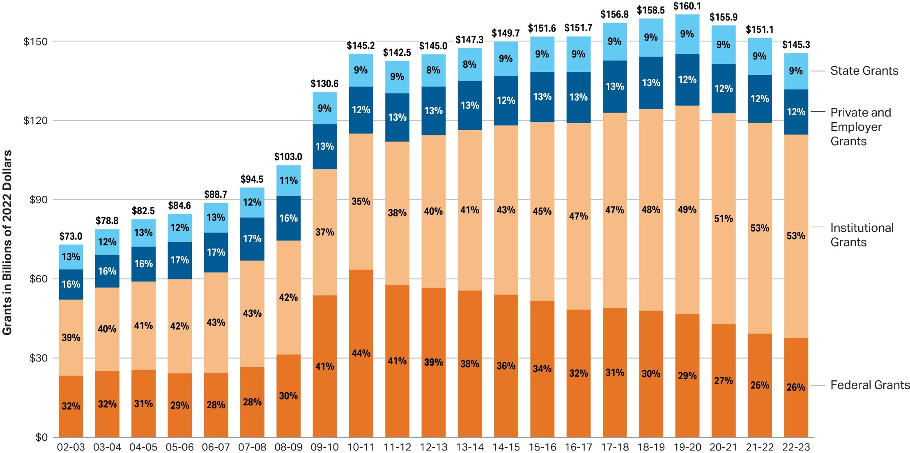
Amount of Federal Grants is Shrinking:
Now Just 26% of Smaller Total of All Grant Aid
Data from 2002-03 to 2022-23
Source: The College Board, Trends in College Pricing and Student Aid 2023, Figure SA- 5.

Slide 15
Millions of Recipients by Federal Aid Program (with Average Aid Received), 2022-23
Number of Recipients in millions
Source: The College Board, Trends in College Pricing and Student Aid 2022, Figure SA- 7.

Slide 16
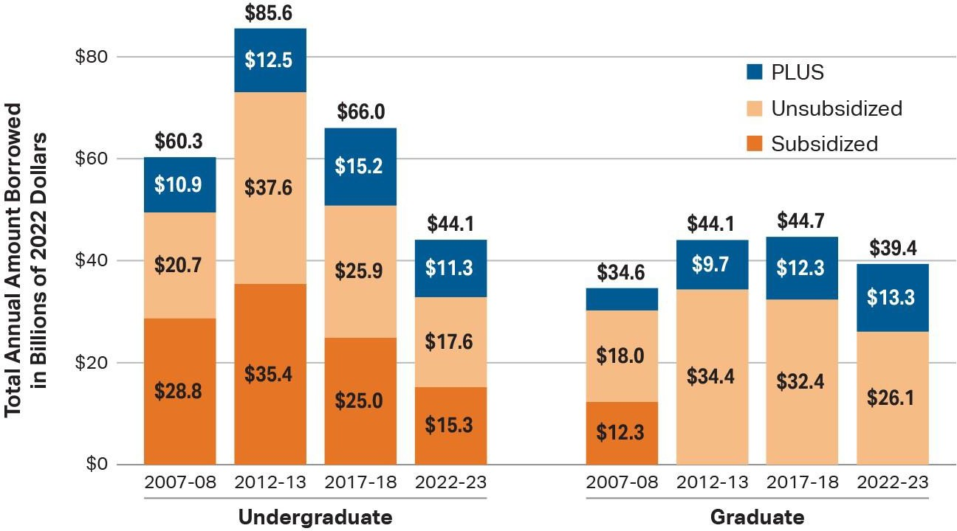
Loan Levels Fall for All Types of Federal Student Loans Except for Graduate PLUS Loans
Source: The College Board, Trends in College Pricing and Student Aid 2023, Figure SA- 9A.

Slide 17
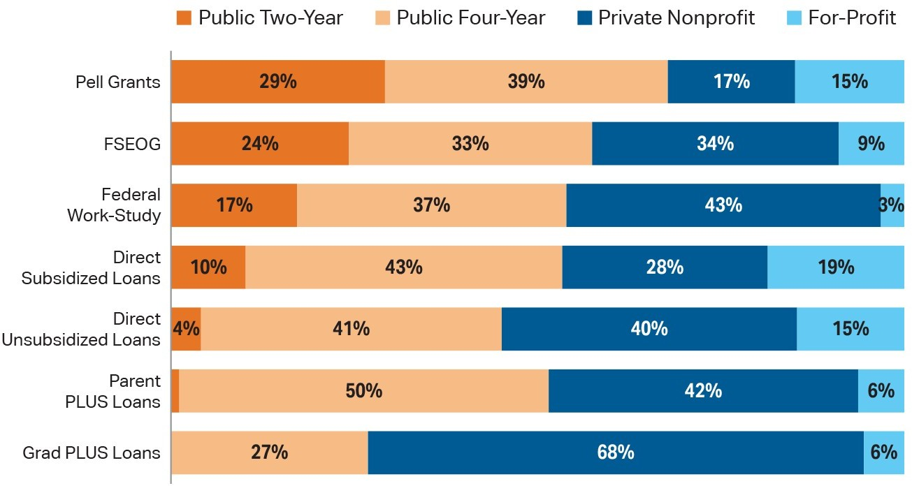
Federal student aid by type of institution, 2021-22
Fall 2021 enrollment by sector: Public Two-Year: 24%;
Public Four-Year: 45%; Private Nonprofit: 25%; For-Profit: 7%.
Source: The College Board, Trends in College Pricing and Student Aid 2023, Figure SA-8.

Slide 18
Head Start Funding Provides Services to
Fewer Than Half of Eligible Children
51% of eligible children ages 3 and 4 had access to Head Start
10% of eligible children under 3 had access to Early Head Start
Source: HHS Report to Congress on Head Start Eligibility, March 2022

Slide 19
State Funding for Preschool Only Recently Returned to Level of 20 Years Ago
SOURCE: State of Preschool 2022: State Preschool Yearbook, The National Institute for Early Education Research, http://nieer.org

