Slide 1

President’s FY 2026 Budget Makes Huge Education Cut: Funding already failed to keep pace with need or Inflation (Department of Education Discretionary Funding in Billions of Dollars)
2017, 2019, 2020, 2021, 2022, & 2023 totals reflect rescissions of previously appropriated ED funding
Notes:
PLACEHOLDER 2024 and footnote on Pell

Slide 2
Majority of voters want to increase federal education funding
Source: All4Edpoll conducted Oct. 30-Nov. 5, 2024
https://all4ed.org/publication/voters-views-on-education-in-2024/

Slide 3
Department of Education Funding: President’s Requested Change and Enacted Change
Obama
Trump
Biden
Trump
Source: Department of Education FY 2026 request and budget history tables

Slide 4
Education Funding Other than Emergency Relief Held Mostly Flat – President’s FY 2026 Budget is below 2011 Funding Level (Department of Education Discretionary Funding in Billions of Dollars)
2017, 2019, 2020, 2021, 2022 & 2023 regular totals reflect rescissions of Pell Grant funds

Slide 5
President’s FY 2026 Education Department Discretionary Funding
Source: CEF based on Education Department budget request

Slide 6
Federal Funding Has Barely Increased Over the Last 15 Years Except for K-12 Education (Discretionary nominal dollars, in billions)

Slide 7
Special Education: Federal Share About 1/4 of “Full Funding,” Leaving Cost Burden to State and Local Budgets
Source: CRS and ED funding history
Notes:
% of full funding, 1988-2017 from https://ncd.gov/sites/default/files/NCD_BrokenPromises_508.pdf
% covered for 2023=2025 Pres in FY 25 CJ, table on page 25

Slide 8
Head Start Funding Provides Services to
Fewer Than Half of Eligible Children
51% of eligible children ages 3 and 4 had access to Head Start
10% of eligible children under 3 had access to Early Head Start
Source: HHS Report to Congress on Head Start Eligibility, March 2022

Slide 9
State Funding for Preschool Only Recently Returned to Level of 22 Years Ago
SOURCE: State of Preschool 2024: State Preschool Yearbook, The National Institute for Early Education Research, http://nieer.org

Slide 10
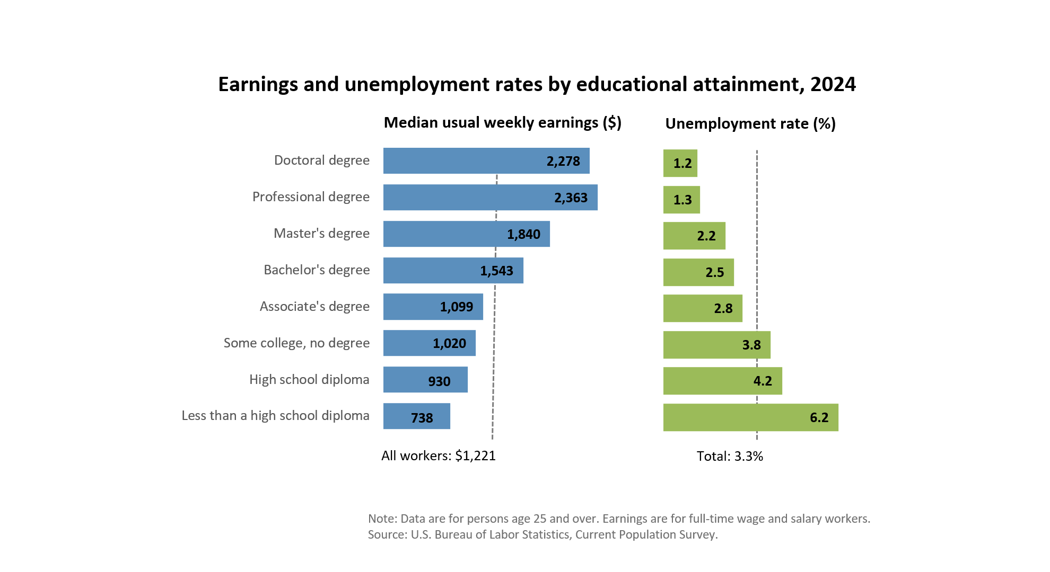

Education Pays: More Education Leads to Higher Wages and Employment

Slide 11
President’s Budget Slashes Maximum Pell Grant That Already No Longer Covers Much of Average Cost of College
$24,920
Source: College Board “Trends in College Pricing 2024” and ED

Slide 12
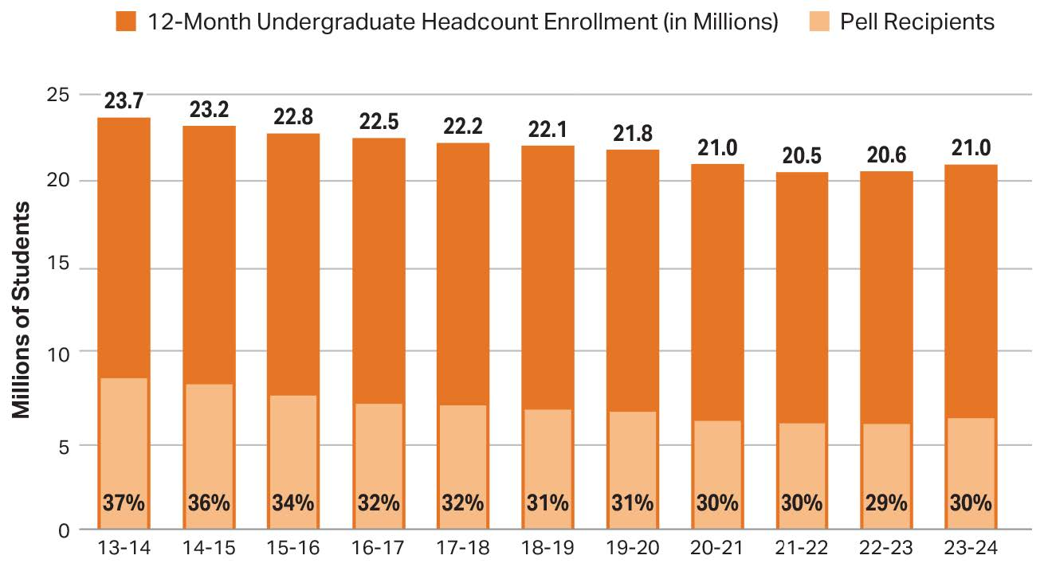
Almost One-Third of Undergraduates Rely on
Pell Grants
Source: The College Board, Trends in College Pricing and Student Aid 2024, Figure SA- 17A.

Slide 13
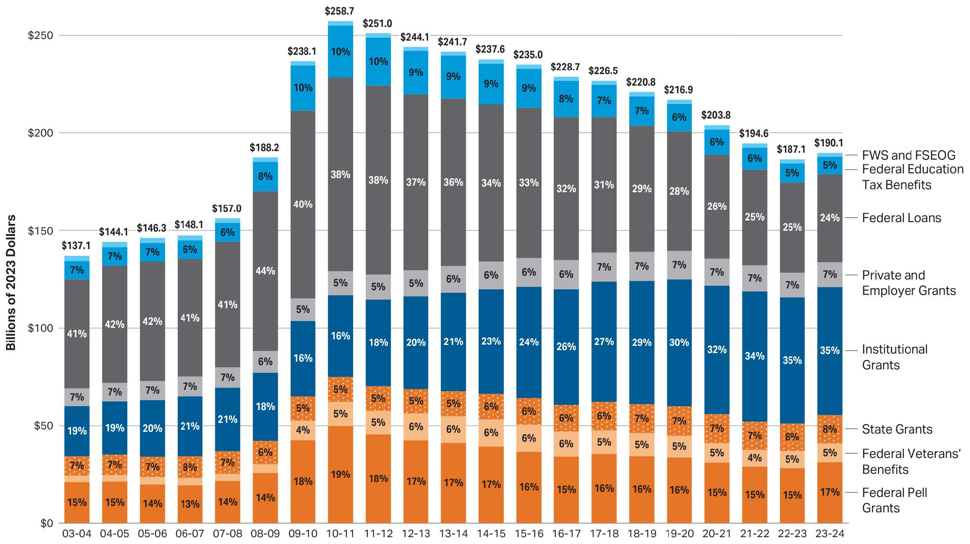
Federal Support is Only 51% of Undergraduate Student Aid
Source: College Board, Trends in College Pricing and Student Aid 2024, Figure SA-3

Slide 14
Millions of Recipients by Federal Aid Program (with Average Aid Received), 2023-24
Number of Recipients in millions
Source: The College Board, Trends in College Pricing and Student Aid 2024, Figure SA- 7.

Slide 15
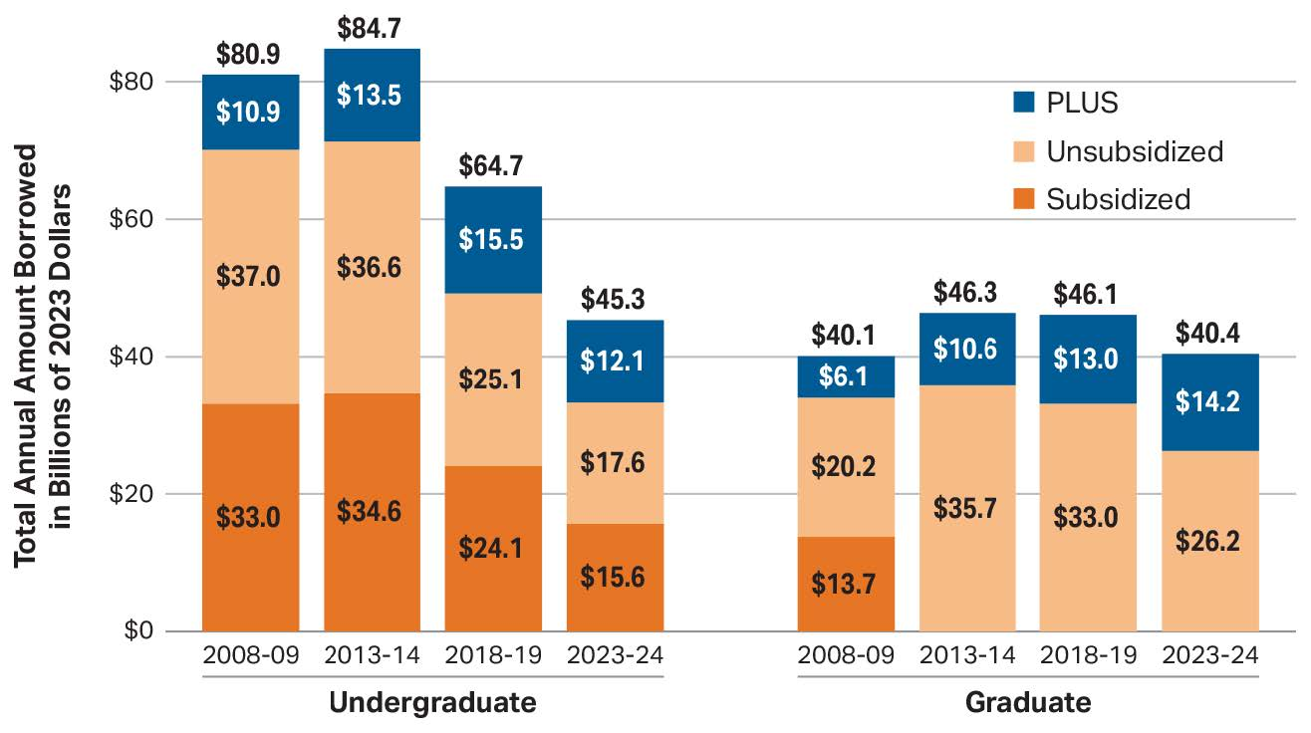
Loan Levels Fall for All Types of Federal Student Loans Except for Graduate PLUS Loans
Source: The College Board, Trends in College Pricing and Student Aid 2024, Figure SA- 9A.

Slide 16
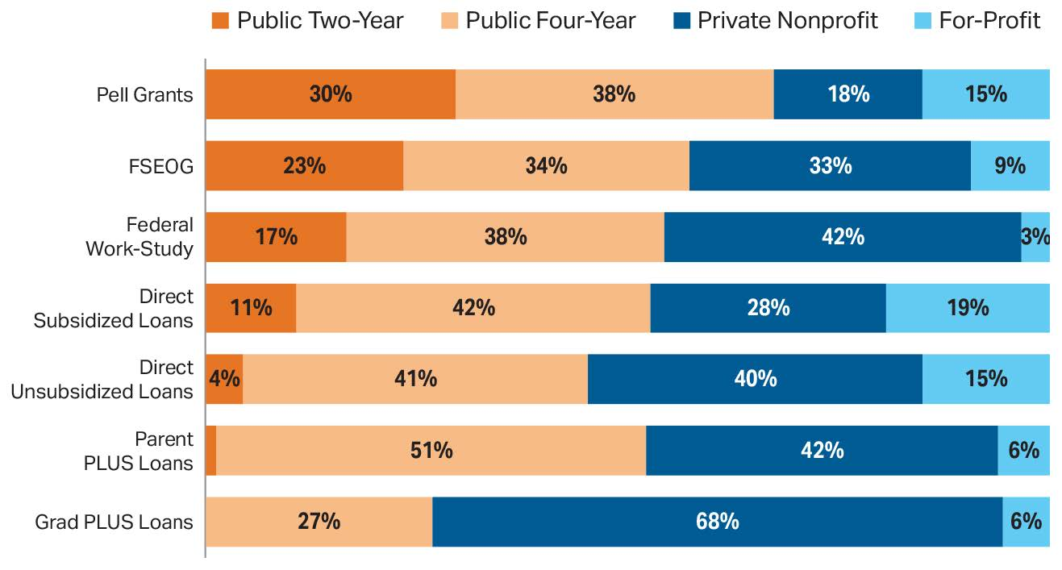
Federal student aid by type of institution, 2021-22
Fall 2022 enrollment by sector: Public Two-Year: 24%;
Public Four-Year: 45%; Private Nonprofit: 25%; For-Profit: 7%.
Source: The College Board, Trends in College Pricing and Student Aid 2024, Figure SA-8.

