Slide 1

President’s FY 2027 Budget Cuts Education:
Funding already failed to keep pace with need or Inflation
(Department of Education Discretionary Funding in Billions of Dollars)
2017, 2019, 2020, 2021, 2022, & 2023 totals reflect rescissions of previously appropriated ED funding
Notes:
PLACEHOLDER 2027

Slide 2
President’s FY 2027 Education Budget Cuts
$14 Billion from Existing Programs
Source: Department of Education FY 2027 request and CBO 2026 Pell Grant baseline estimates

Slide 3
Pell Grants, Title I, and Special Education Account for Almost 90% of President’s FY 2027 Education Department Request
Source: CEF based on Education Department budget request

Slide 4
Department of Education Funding:
President’s Requested Change and Enacted Change
Obama
Trump
Biden
Trump
Source: Department of Education FY 2027 request and budget history tables
Notes:
Placeholder for 2027

Slide 5
Majority of voters want to increase federal education funding
Source: All4Edpoll conducted Oct. 30-Nov. 5, 2024
https://all4ed.org/publication/voters-views-on-education-in-2024/

Slide 6
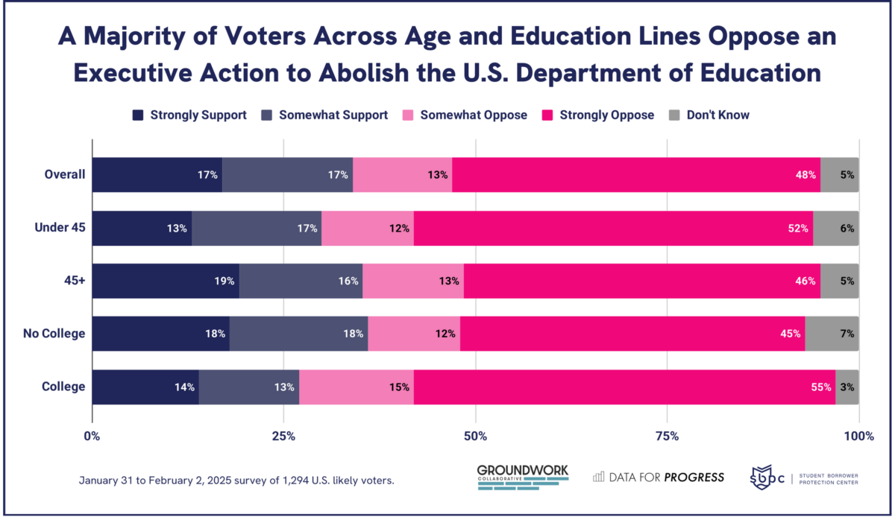
Source: Data for Progress poll conducted Jan, 31-Feb. 2, 2025

Slide 7
Special Education: Federal Share at 1/4 of “Full Funding,” Leaving Cost Burden to State and Local Budgets
Source: CRS and ED funding history
Notes:
% of full funding, 1988-2017 from https://ncd.gov/sites/default/files/NCD_BrokenPromises_508.pdf
% covered for 2023=2025 Pres in FY 25 CJ, table on page 25

Slide 8
Maximum Pell Grant Frozen for Four Years,
Now Covers Less Than 1/3 of Average Cost of College
$25,850
$7,395
Source: College Board “Trends in College Pricing 2025” and ED

Slide 9
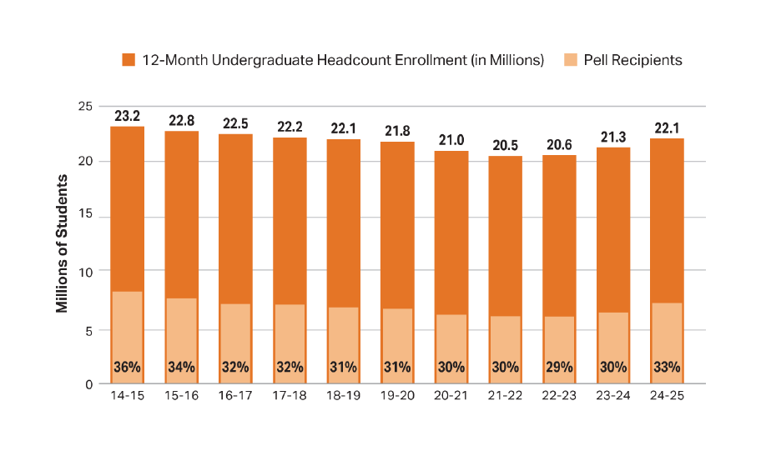
One-Third of Undergraduates Rely on
Pell Grants
Source: The College Board, Trends in College Pricing and Student Aid 2025, Figure SA- 17A.

Slide 10
Pell Grant Funding Sources:
Discretionary Grant Only
Estimates
Sources: Congressional Budget Office baseline data

Slide 11
Millions of Recipients by Federal Aid Program (with Average Aid Received), 2024-25
Number of Recipients in millions
Source: The College Board, Trends in College Pricing and Student Aid 2025, Figure SA- 7.

Slide 12
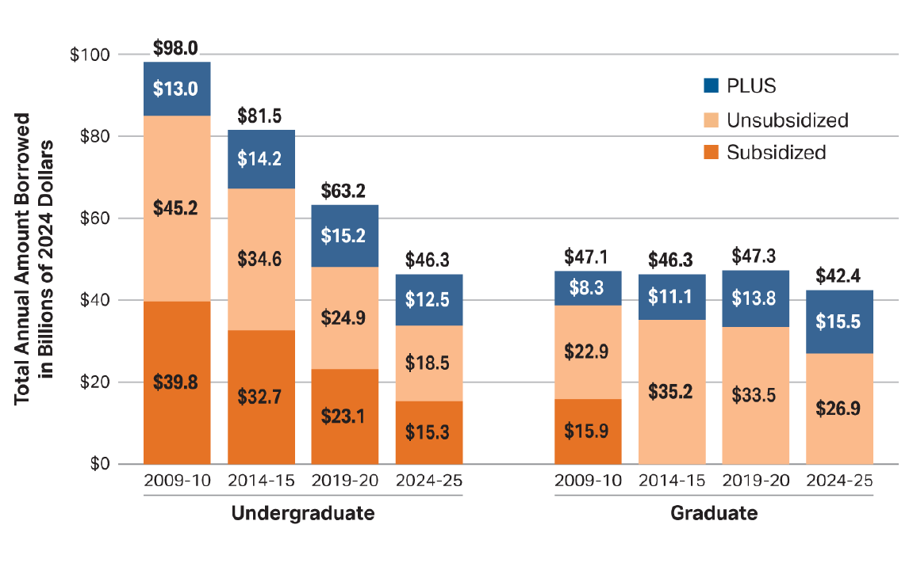
Loan Levels Fall for All Types of Federal Student Loans Except for Graduate PLUS Loans
Source: The College Board, Trends in College Pricing and Student Aid 2025, Figure SA- 9A.

Slide 13
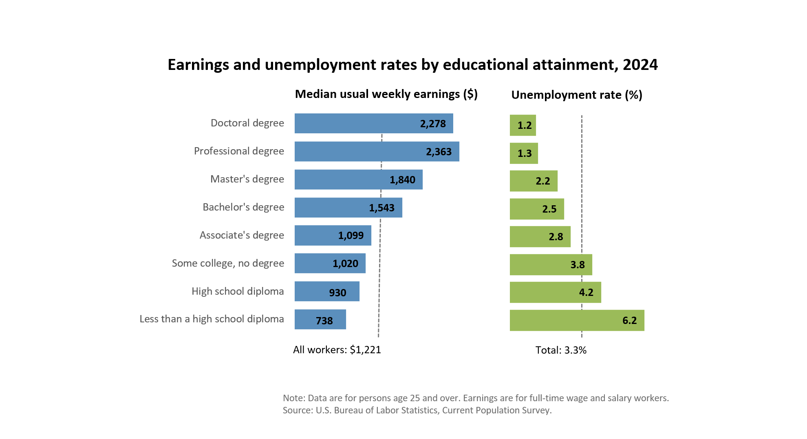

Education Pays: More Education Leads to Higher Wages and Employment

